Slide 1
ALATION ASSIGNMENT
Developing a test automation framework

Slide 2
FRAMEWORK AND TOOLS
Testing framework | TestNG
Language | Java
BDD | Cucumber
Build Automation Tool | Maven
IDE | Eclipse

Slide 3
ENVIRONMENT SETUP
TOOLS | VERSION
Java | 1.8
Selenium and its dependency files | 3.6.0
Cucumber | 1.2.5
TestNG | 6.9.10
Windows-OS | 7

Slide 4
WHY TESTNG?
Annotations are easier to understand
Makes parallel testing and data parameterization possible
Test cases can be grouped more easily
Reports can be easily generated in a good format
We can have proper control over the test execution

Slide 5
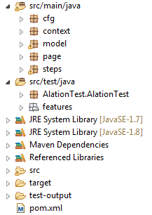
PROJECT STRUCTURE

Slide 6
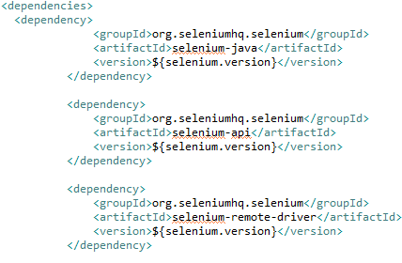
POM.XML

Slide 7
FEATUREs USING SCENARIO OUTLINE-CUCUMBER
Values no longer need to be hard-coded in step definitions.
Values are replaced with parameters as <parameter_name> in step-definition itself.
Values are defined in a pipe-delimited table format using Examples.
A Scenario Outline is run once for each row in the Examples section beneath it
Scenario Outline makes steps as generic as possible

Slide 8
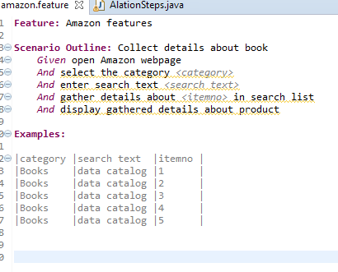
CUCUMBER FEATURE FILE -amazon.feature

Slide 9
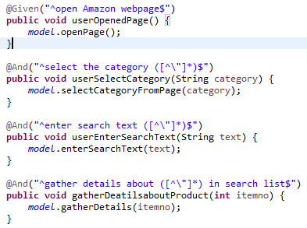
GHERKIN STEPS – steps.java

Slide 10
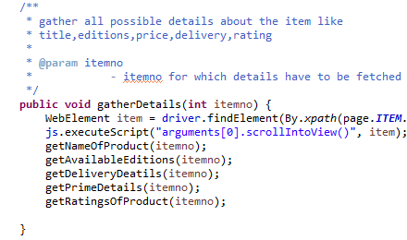
METHOD IMPLEMENTATION – model.java

Slide 11
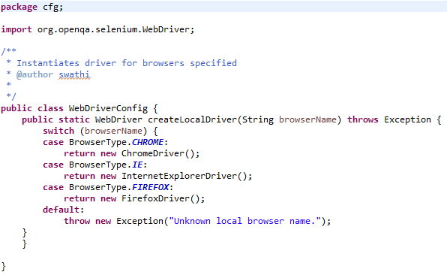
CONFIGURATION –CHOICE OF BROWSER : WebDriverConfig.java

Slide 12
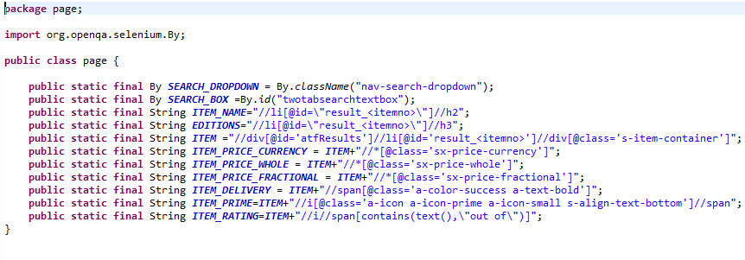
LOCATORS –page.java

Slide 13
CHOICE OF LOCATORS
First choice of selectors should be ID’s since they are meant to be unique in the page.
CSS or Xpath locator is formed by starting with an element that is not likely to change much and use it as an ‘anchor’ in the locator.
Multiple elements matching same xpath/css : In the amazon webpage, the details “prime” and “rating” shared the same xpath,
//div[@id='atfResults']//li[@id='result_0']//div[@class='s-item-container’]//i//span[@class=“a-icon-alt”]
So to eliminate this, to find a unique xpath to “rating”,
//div[@id='atfResults']//li[@id='result_0']//div[@class='s-item-container’]//i//span[contains(text(),\"out of\")]

Slide 14
CHOICE OF LOCATORS
Avoided direct descendants without locators like //div/div/ul/li/span
Eliminated long xpath using descendants/siblings or successors having unique attributes.

Slide 15
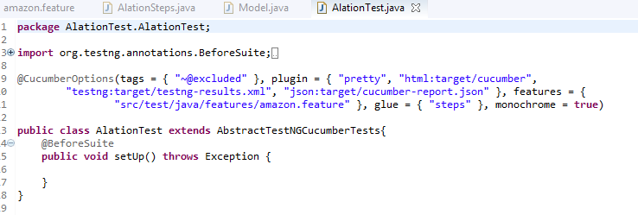
Test file – alationtest.java

Slide 16
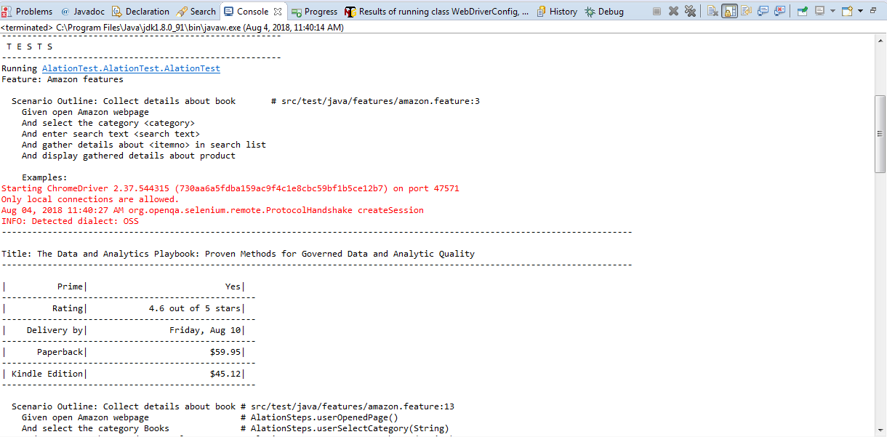

Slide 17
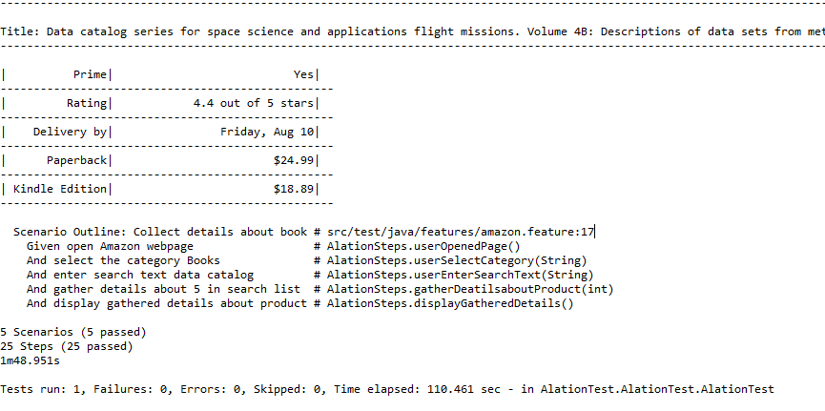

Slide 18
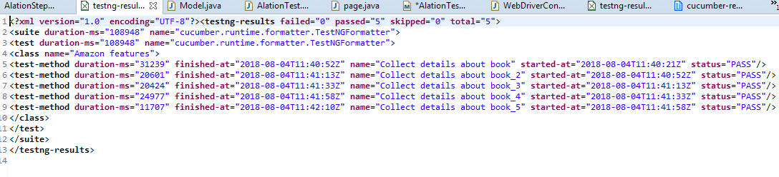
TESTNG-RESULTS.XML

Slide 19
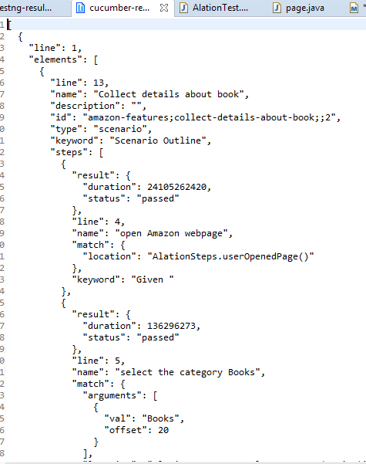
CUCUMBER-REPORTS.JSON

Slide 20
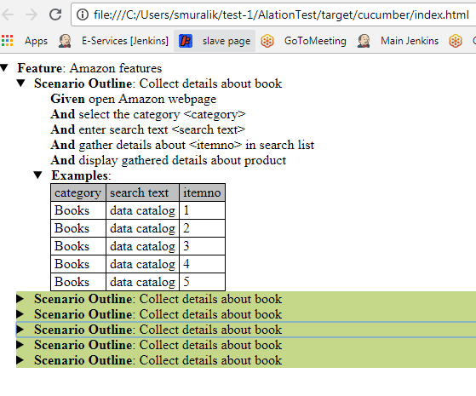
HTML REPORT

Slide 21
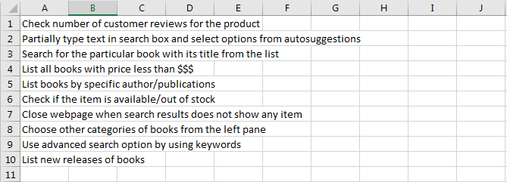
POSSIBLE TEST CASES

Slide 22
WHAT COULD FURTHER BE IMPROVED if we go beyond time constraint
Deep gathering of information about the list items
Store and display search results in a more efficient manner
Could have also provided support for gathering details for item in successive pages(2,3…n)

